Slide 1
CEG5304 / EE6934 (PT2)
Lecture 11:
Transfer and Few-Shot Learning

Slide 2
Admin Issues for Week 11
Quick reminder to begin your assignment, preferably before the end of the semester.
Due on 20th April. Late submissions are strict.
Marks for Assignment 1 may not be available until End April due to the immense workload, thank you for understanding!
Finals: please write to citbox25@nus.edu.sg for any technical issues faced (including no laptops ☹) for the computer-based final exam, cc me for your conversations.
But please don’t ask me to borrow you laptops ☹.

Slide 3
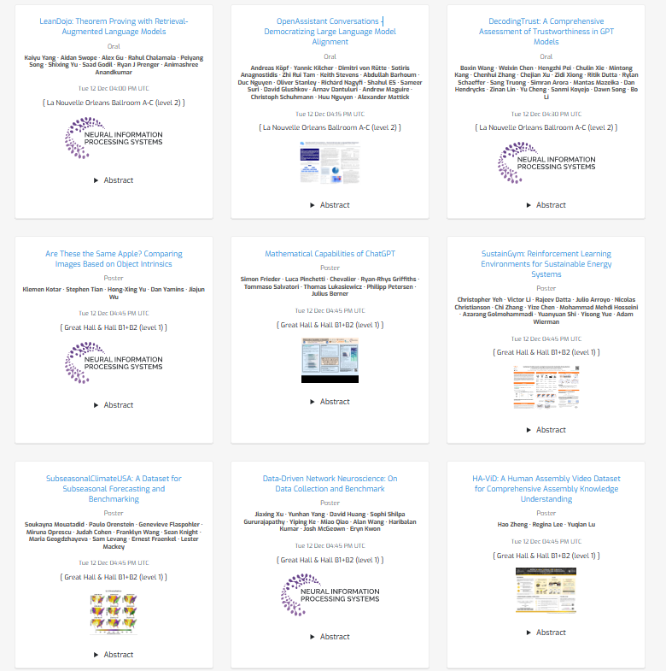
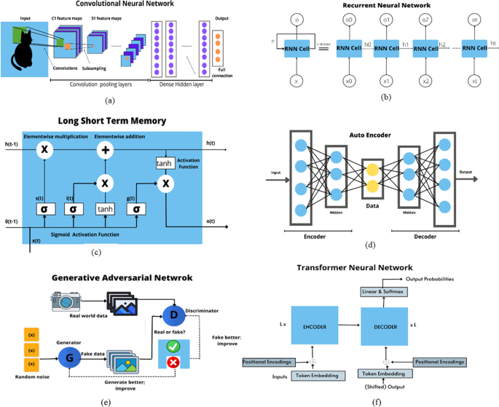
The Background: Training in Deep Learning
The two pillars of DL Training: the Model and Data

Slide 4
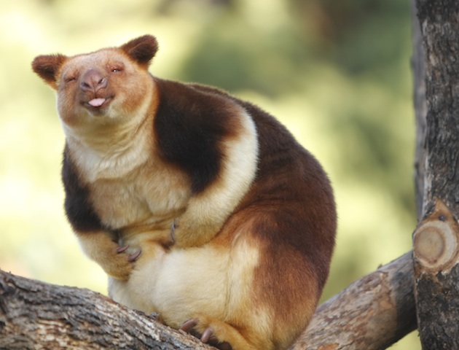
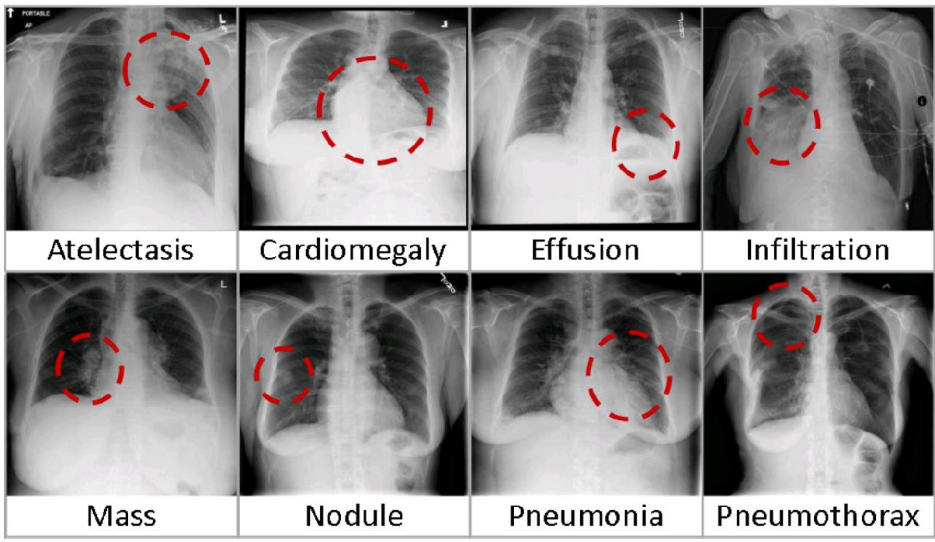
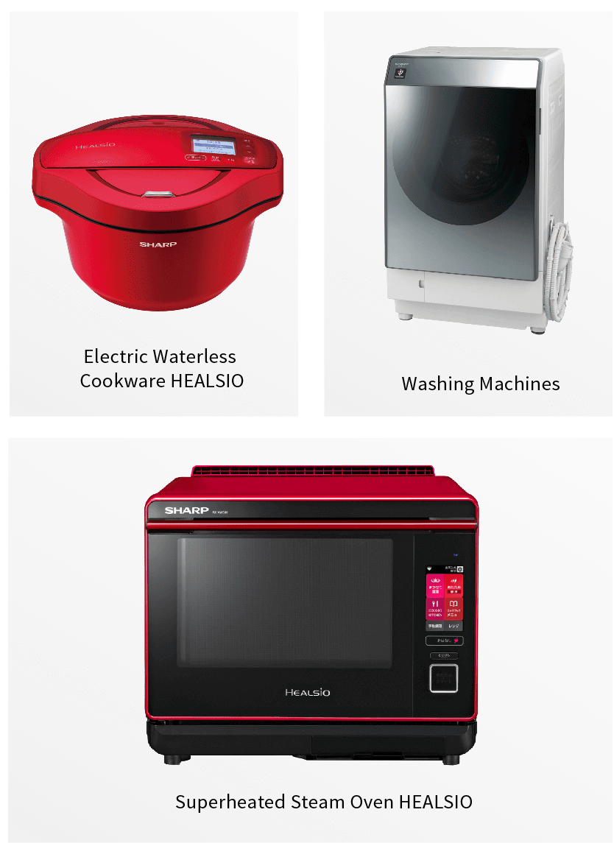
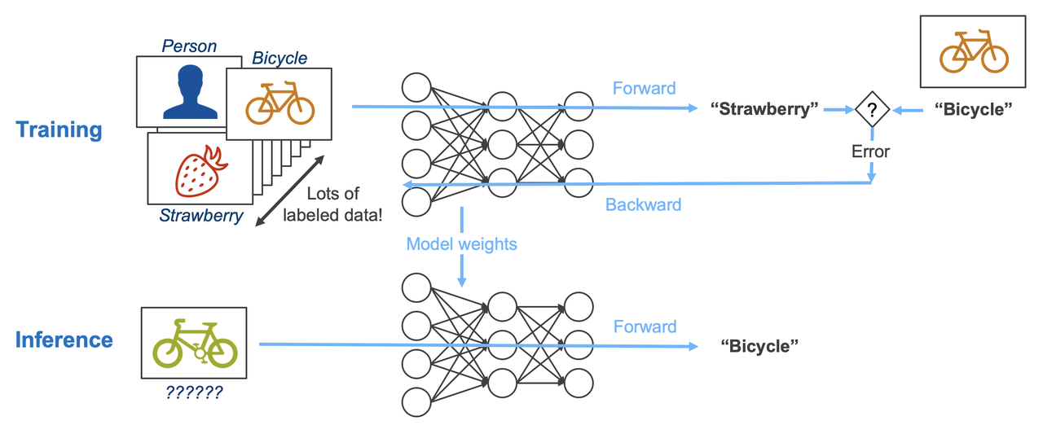
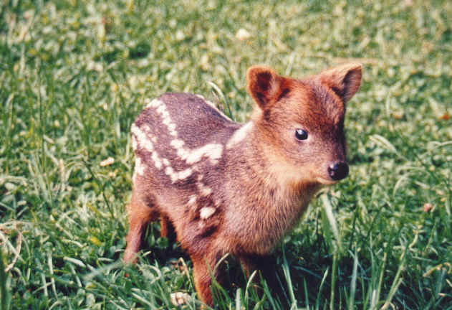
Training in Deep Learning
Is the usual training paradigm enough for deep learning?
Yes? Larger models + More data – better model capability, applicable to more scenarios (better generalizability).
What are the constraints? Consider the following scenarios:
Rare classes (rare animals)
Sensitive data (Medical images)
Limited power (AIoT/Edge devices)

Slide 5
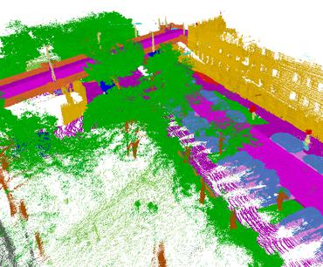
Limitations: The Real-World Applications
The real-world cases:
Data may not be readily available or;
Data may be too sensitive to share!
Even if they are available:
Annotation requires huge computation cost!
More often: may not have enough computation power to handle even the inference of large models.
What should we do?
Learning with less data!
Learning beyond the current scenario!

Slide 6
Transfer Learning and Domain Adaptation
Concepts and Notations of Transfer Learning
Domain Adaptation

Slide 7
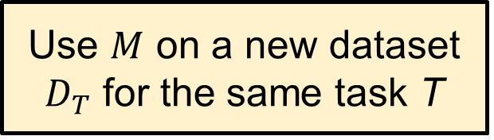
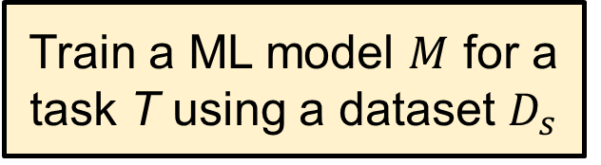
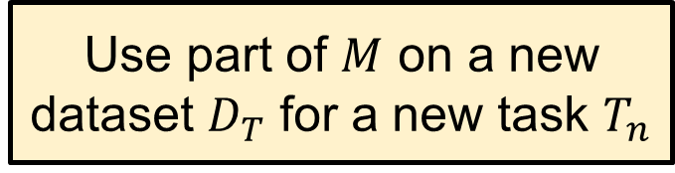
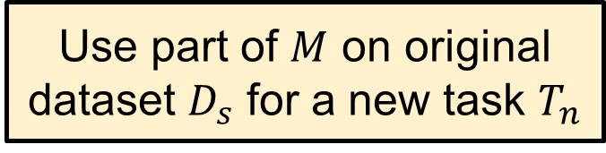
Transfer Learning: the Basic Idea
The definition: Transfer learning (TL) focuses on storing knowledge gained while solving one problem and applying it to a different but related problem.
Train a ML model $M$ for a task T using a dataset $D_{s}$
Use $M$ on a new dataset $D_{T}$ for the same task T
Use part of $M$ on original dataset $D_{s}$ for a new task $T_{n}$
Use part of $M$ on a new dataset $D_{T}$ for a new task $T_{n}$

Slide 8
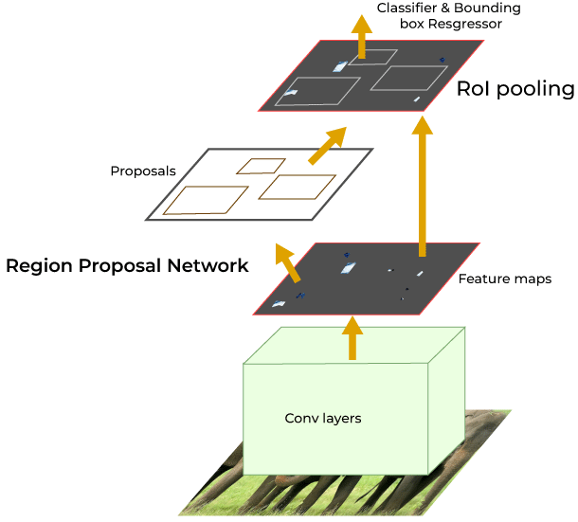
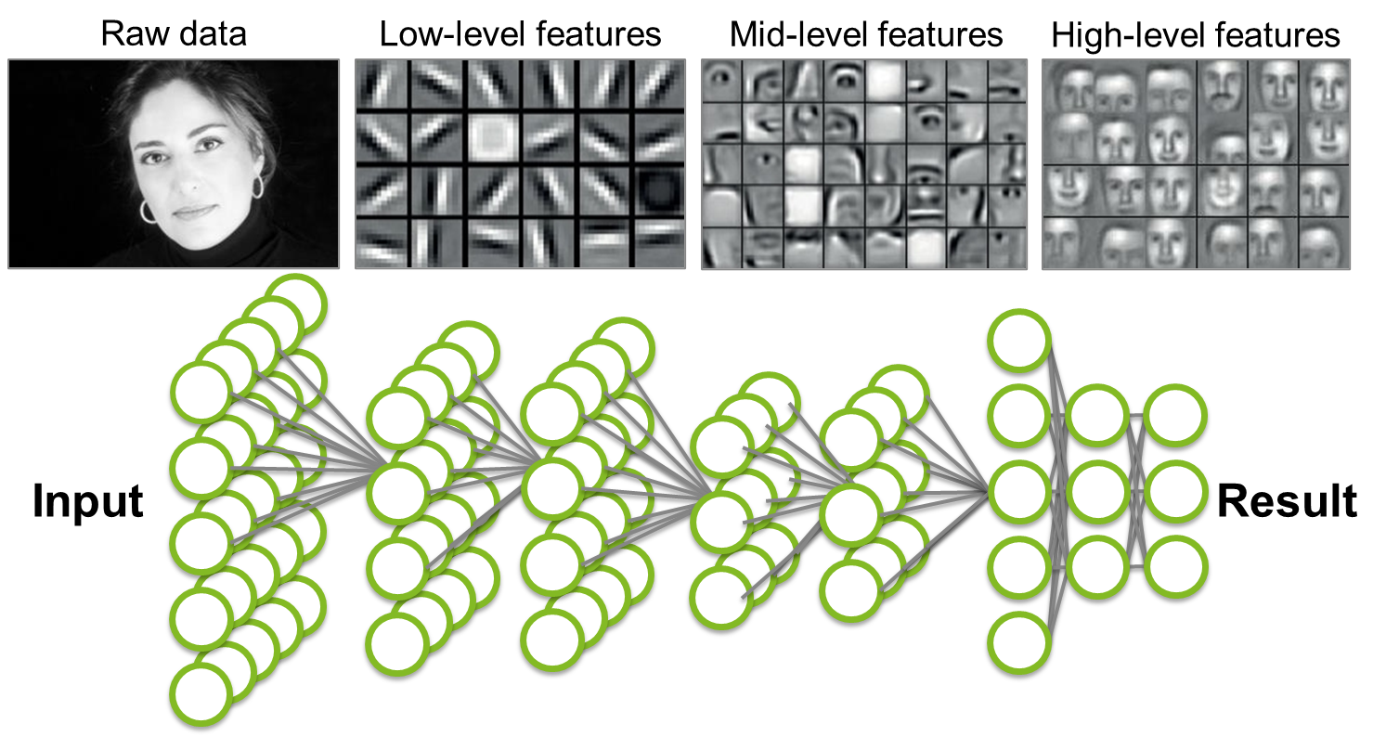
An Example: Training with Pre-trained Models
How to make an image classifier that can be trained in a few minutes on a CPU with very little data?
Use pre-trained models, i.e., models with known weights.
Main Idea: Earlier layers of a network learn low level features, network adapted to new data / tasks by changing weights at high-level layers.
Example: image recognition / object detection models are often trained by initializing from the image models pre-trained on the large ImageNet dataset.

Slide 9
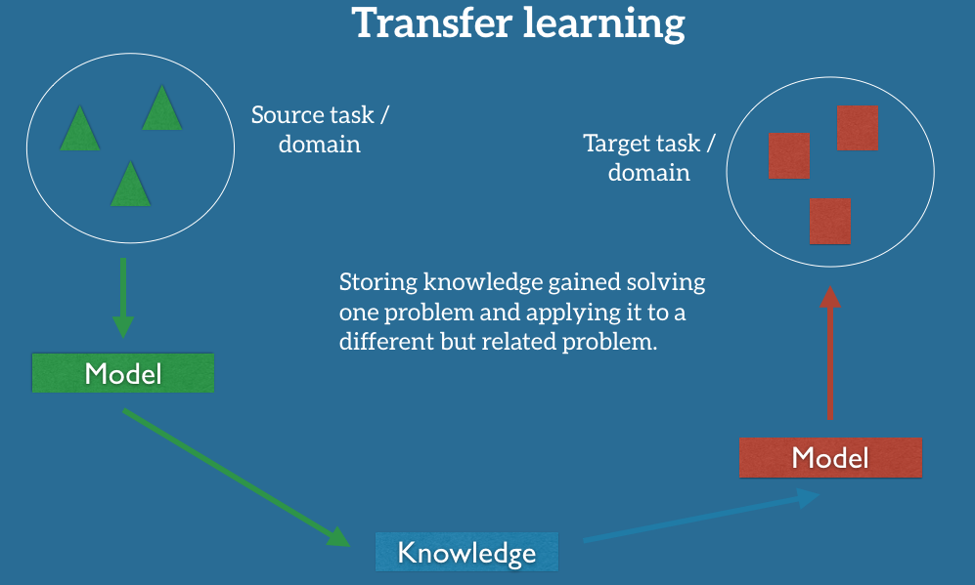
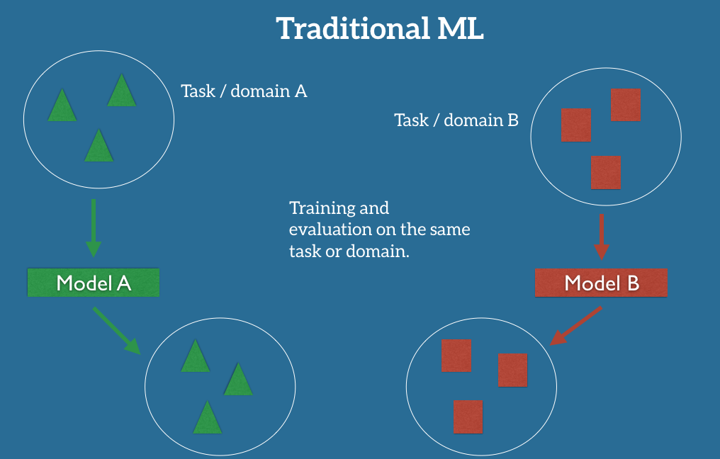
Transfer Learning vs. Traditional DL/ML

Slide 10
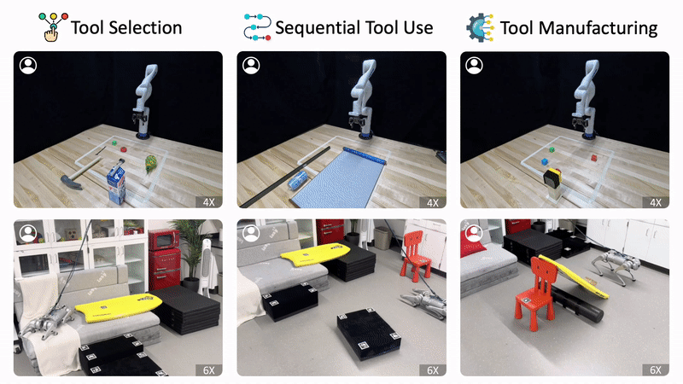
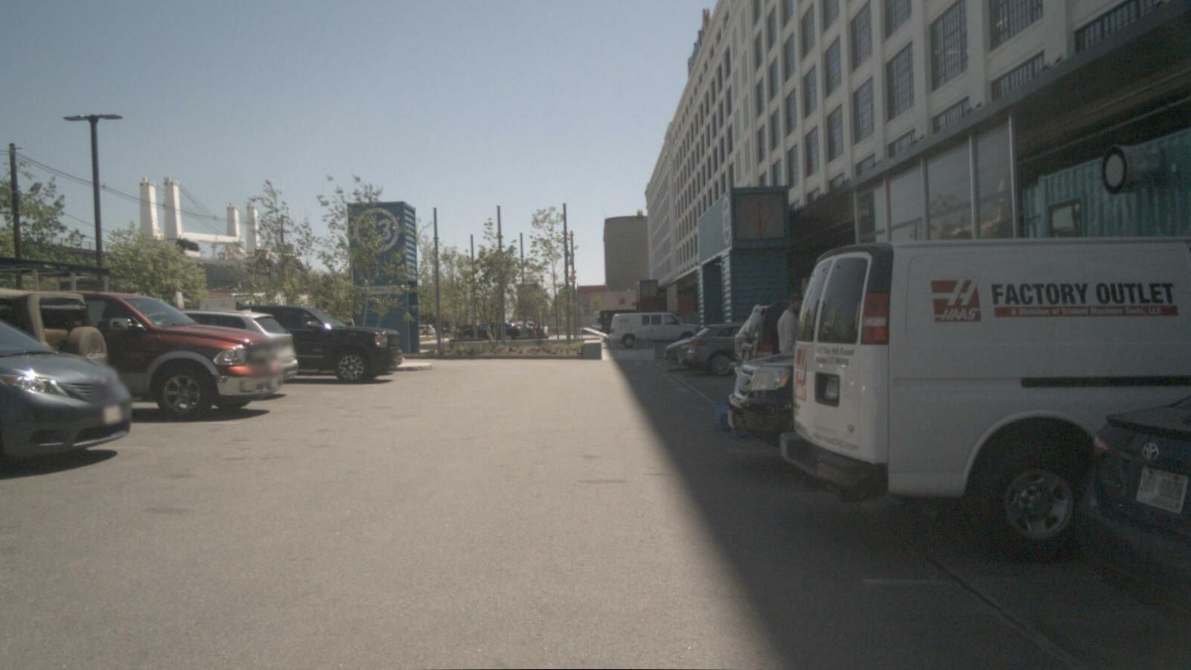
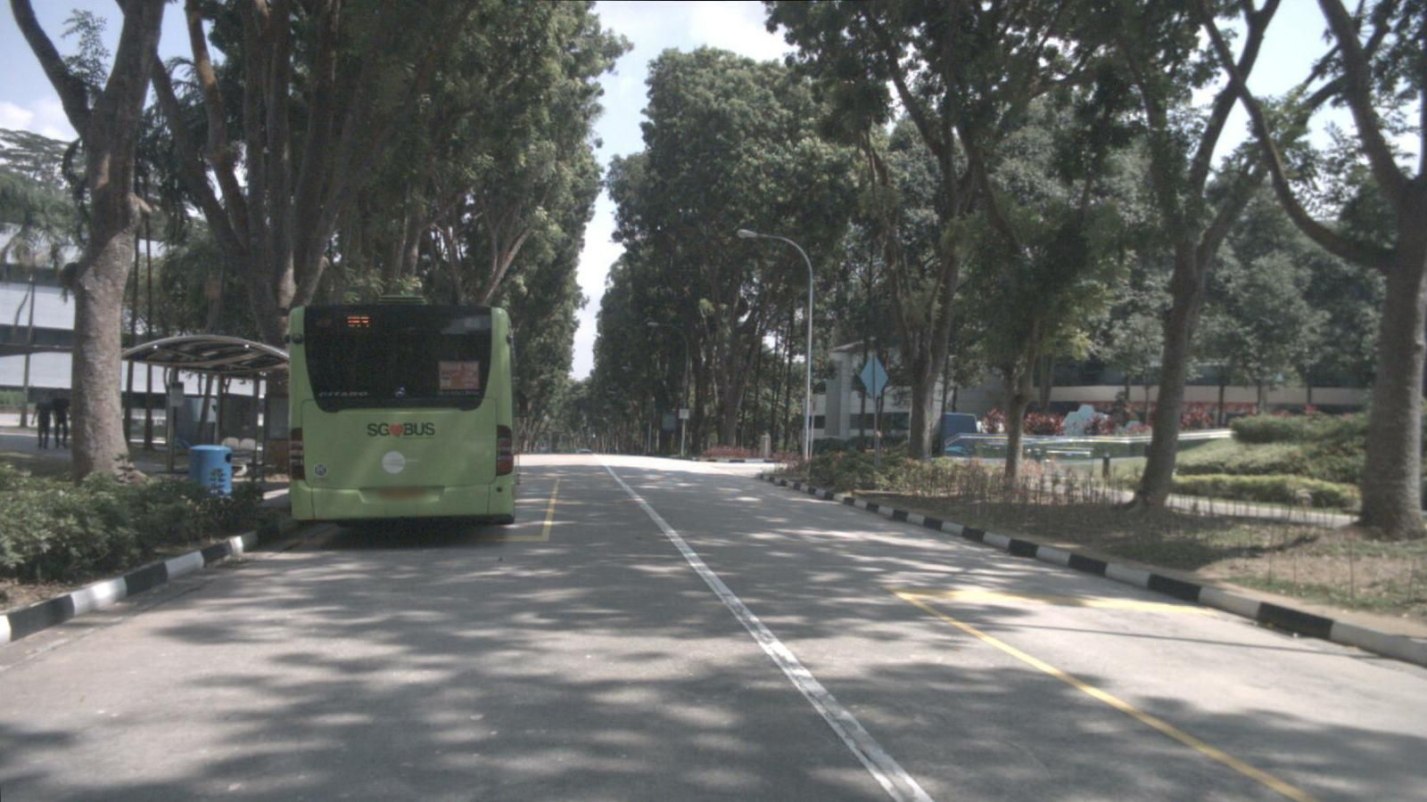
Applications of Transfer Learning
Train Robots from Simulations (Sim2Real)
Train self-driving models across scenes
Speech recognition for immigrants and minorities.
Cross-lingual adaptation for resource-poor languages (English → Nepalis).

Slide 11
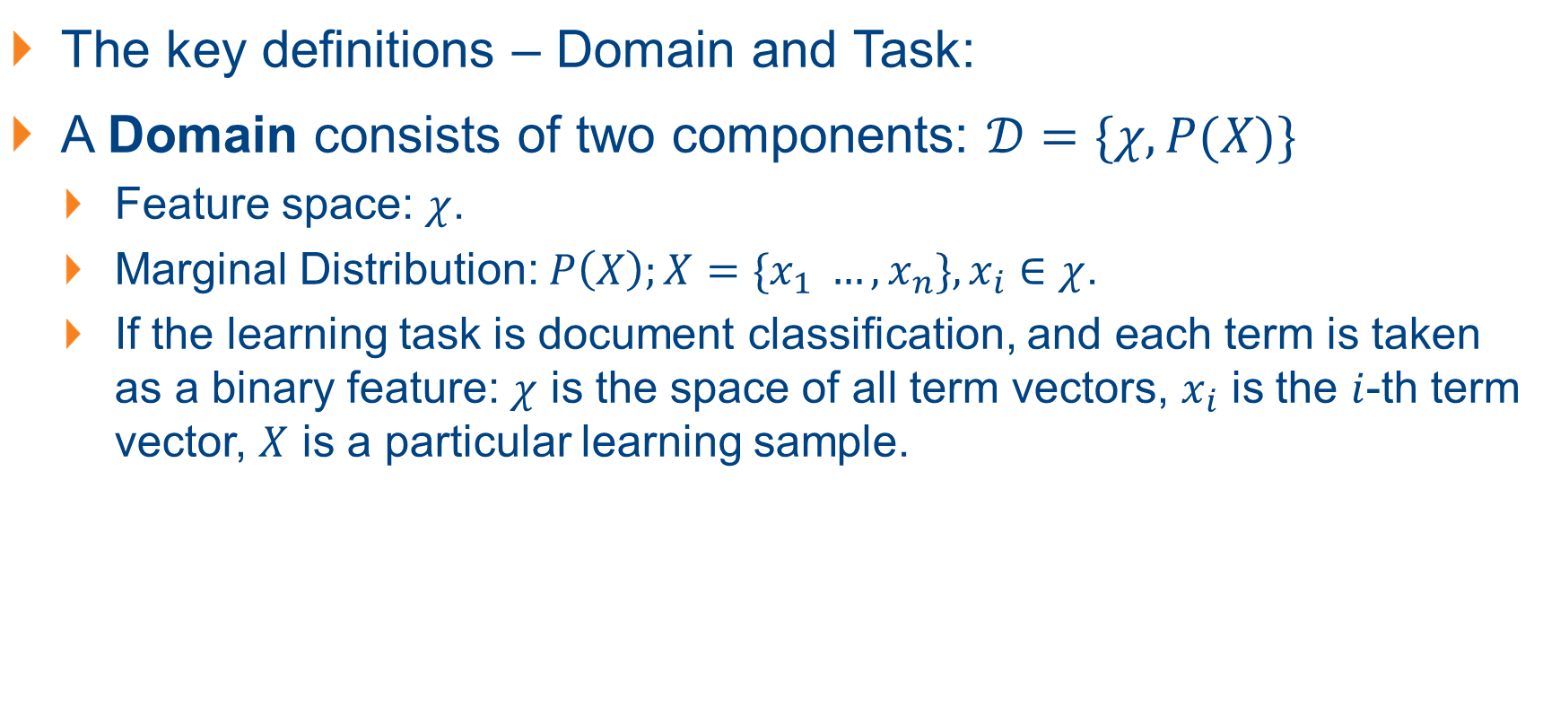
Formal Definitions
The key definitions – Domain and Task:
A Domain consists of two components: $𝒟=\{χ, P(X)\}$
Feature space: $χ$.
Marginal Distribution: $P\left(X\right);X=\{x_{1} …, x_{n}\}, x_{i}∈χ$.
If the learning task is document classification, and each term is taken as a binary feature: $χ$ is the space of all term vectors, $x_{i}$ is the $i$-th term vector, $X$ is a particular learning sample.

Slide 12
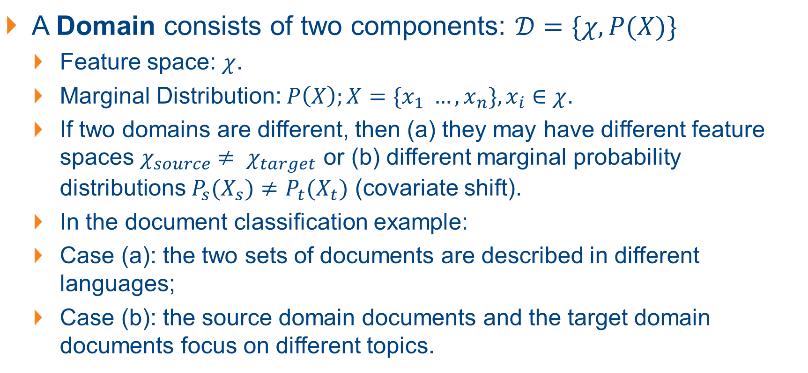
Formal Definitions
A Domain consists of two components: $𝒟=\{χ, P(X)\}$
Feature space: $χ$.
Marginal Distribution: $P\left(X\right);X=\{x_{1} …, x_{n}\}, x_{i}∈χ$.
If two domains are different, then (a) they may have different feature spaces $χ_{source}$ $≠ χ_{target}$ or (b) different marginal probability distributions $P_{s}(X_{s})≠P_{t}(X_{t})$ (covariate shift).
In the document classification example:
Case (a): the two sets of documents are described in different languages;
Case (b): the source domain documents and the target domain documents focus on different topics.

Slide 13
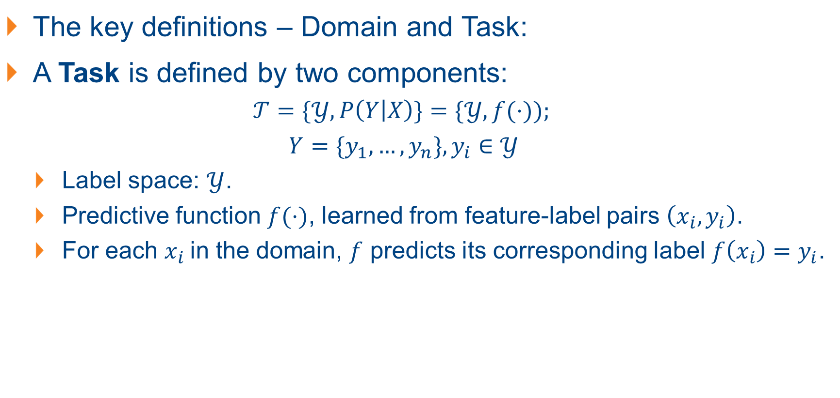
Formal Definitions
The key definitions – Domain and Task:
A Task is defined by two components:
$$𝒯=\{𝒴, P\left(Y | X\right)\}=\{𝒴, f(⋅));$$
$$Y=\{y_{1},…, y_{n}\}, y_{i}∈𝒴$$
Label space: $𝒴$.
Predictive function $f(⋅)$, learned from feature-label pairs $\left(x_{i},y_{i}\right)$.
For each $x_{i}$in the domain, $f$ predicts its corresponding label $f\left(x_{i}\right)=y_{i}$.

Slide 14
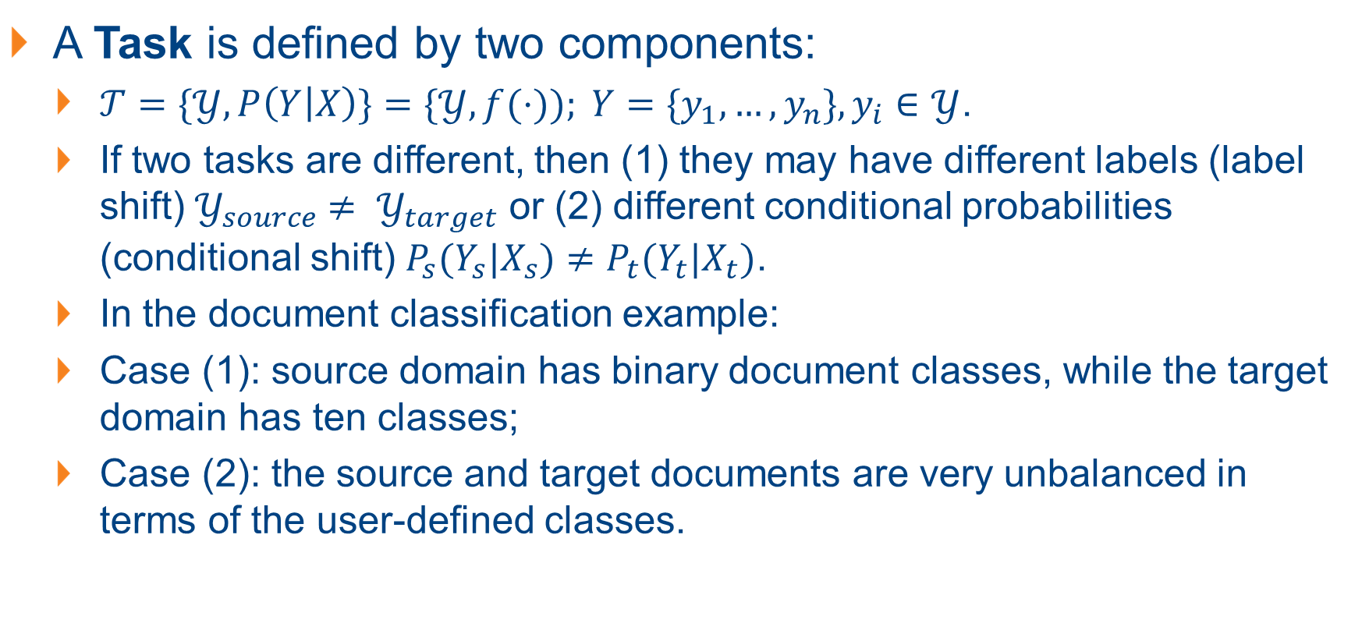
Formal Definitions
A Task is defined by two components:
$𝒯=\{𝒴, P\left(Y | X\right)\}=\{𝒴, f(⋅)); Y=\{y_{1},…, y_{n}\}, y_{i}∈𝒴$.
If two tasks are different, then (1) they may have different labels (label shift) $𝒴_{source}$ $≠ 𝒴_{target}$ or (2) different conditional probabilities (conditional shift) $P_{s}(Y_{s}|X_{s})≠P_{t}(Y_{t}|X_{t})$.
In the document classification example:
Case (1): source domain has binary document classes, while the target domain has ten classes;
Case (2): the source and target documents are very unbalanced in terms of the user-defined classes.

Slide 15
The Key Towards Transfer Learning
During the process of transfer learning, the following three important questions must be answered:
What to transfer? Identify which portion of knowledge is source-specific and what is common between the source and the target.
When to transfer? Aim at utilizing transfer learning to improve target task performance/results and not degrade them. We need to be careful about when to transfer and when not to.
How to transfer? Changes to existing algorithms and different techniques.

Slide 16
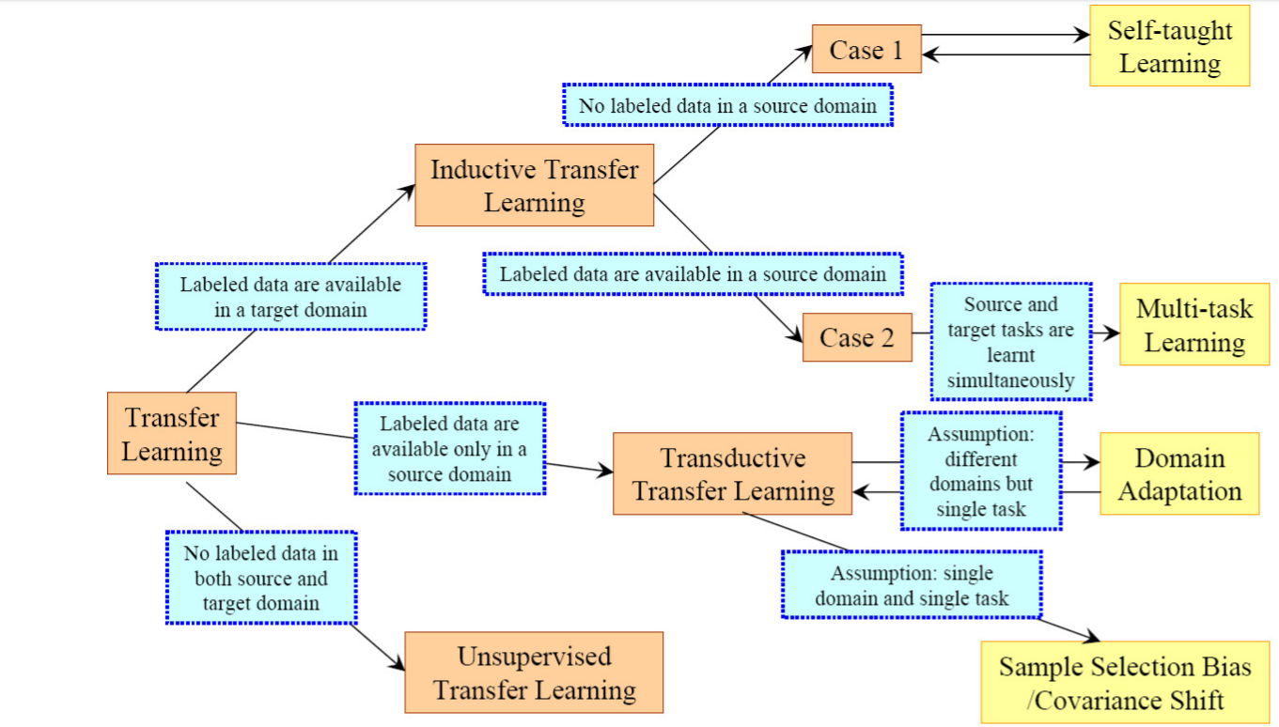
Categorizing Transfer Learning

Slide 17
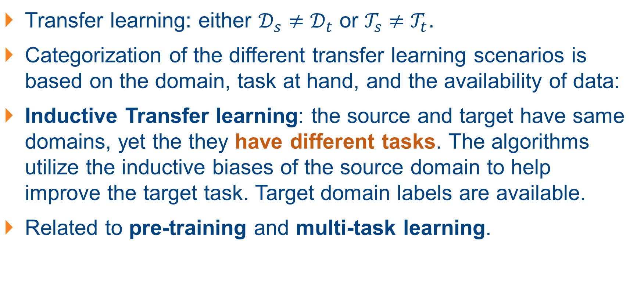
Categorizing Transfer Learning
Transfer learning: either $𝒟_{s}≠𝒟_{t}$ or $𝒯_{s}≠𝒯_{t}$.
Categorization of the different transfer learning scenarios is based on the domain, task at hand, and the availability of data:
Inductive Transfer learning: the source and target have same domains, yet the they have different tasks. The algorithms utilize the inductive biases of the source domain to help improve the target task. Target domain labels are available.
Related to pre-training and multi-task learning.
Notes:
Inductive: 归纳的

Slide 18
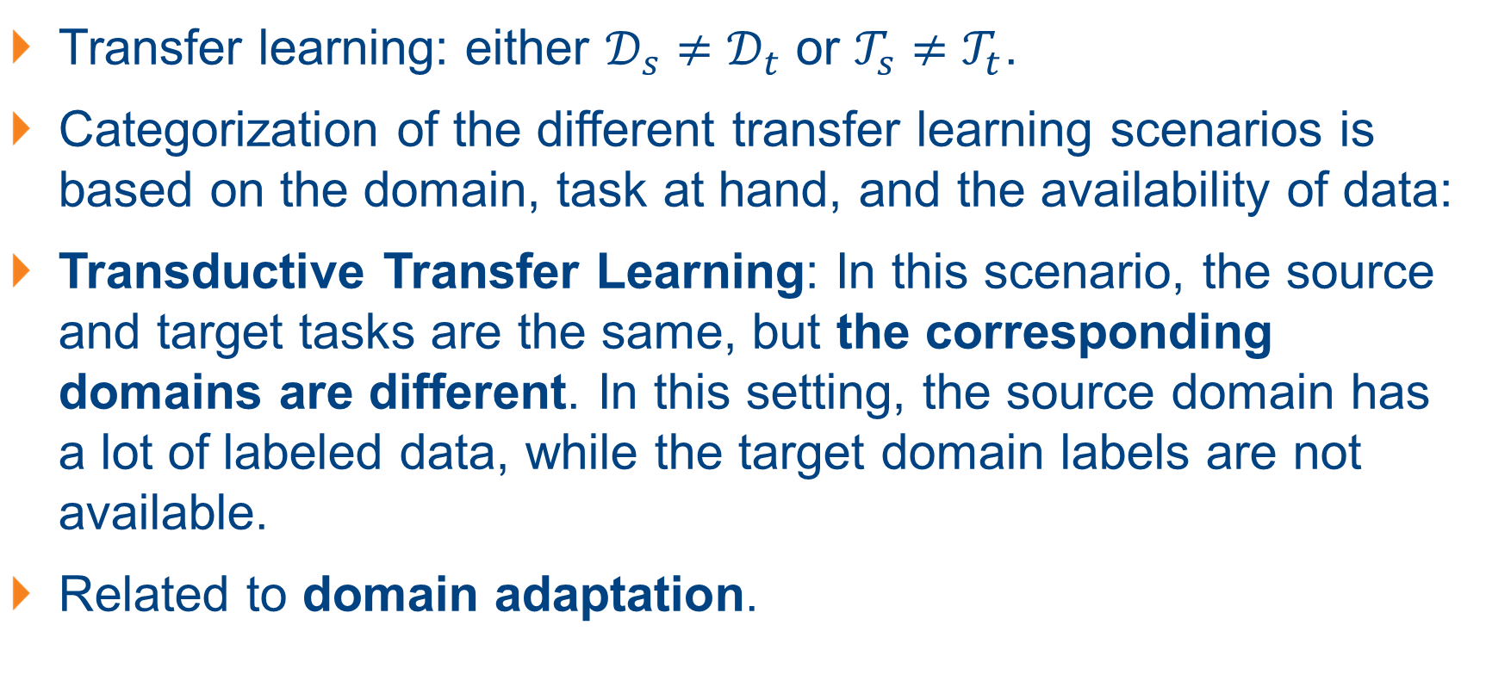
Categorizing Transfer Learning
Transfer learning: either $𝒟_{s}≠𝒟_{t}$ or $𝒯_{s}≠𝒯_{t}$.
Categorization of the different transfer learning scenarios is based on the domain, task at hand, and the availability of data:
Transductive Transfer Learning: In this scenario, the source and target tasks are the same, but the corresponding domains are different. In this setting, the source domain has a lot of labeled data, while the target domain labels are not available.
Related to domain adaptation.
Notes:
transductive：转导性的

Slide 19
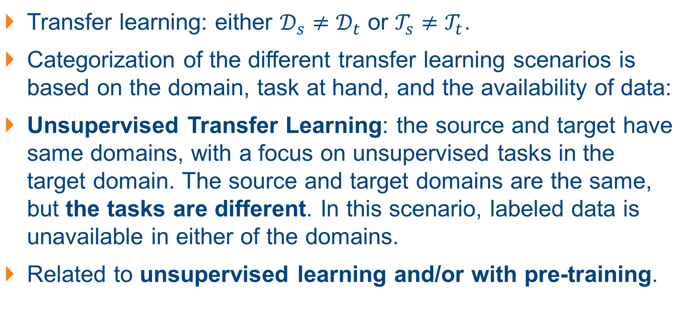
Categorizing Transfer Learning
Transfer learning: either $𝒟_{s}≠𝒟_{t}$ or $𝒯_{s}≠𝒯_{t}$.
Categorization of the different transfer learning scenarios is based on the domain, task at hand, and the availability of data:
Unsupervised Transfer Learning: the source and target have same domains, with a focus on unsupervised tasks in the target domain. The source and target domains are the same, but the tasks are different. In this scenario, labeled data is unavailable in either of the domains.
Related to unsupervised learning and/or with pre-training.

Slide 20
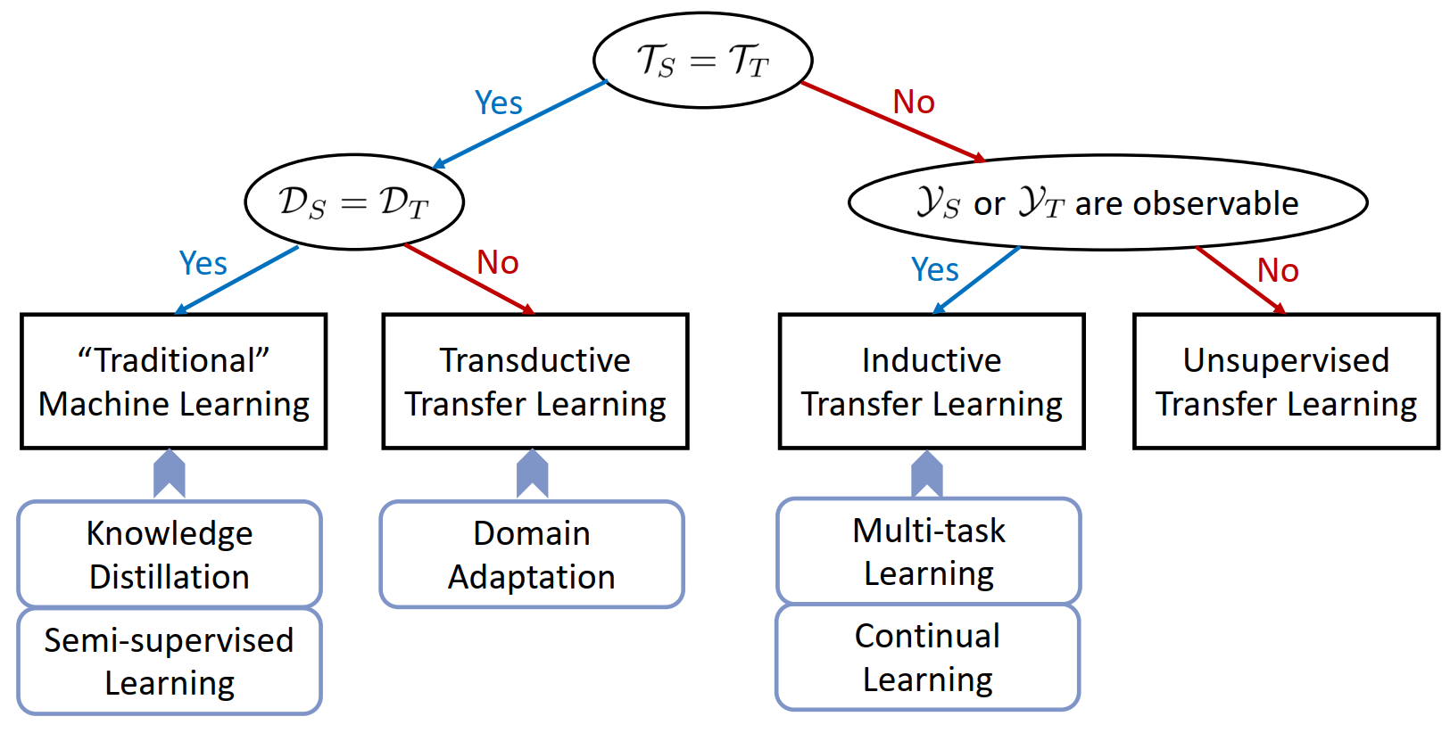
Categorizing Transfer Learning: An Alternative

Slide 21
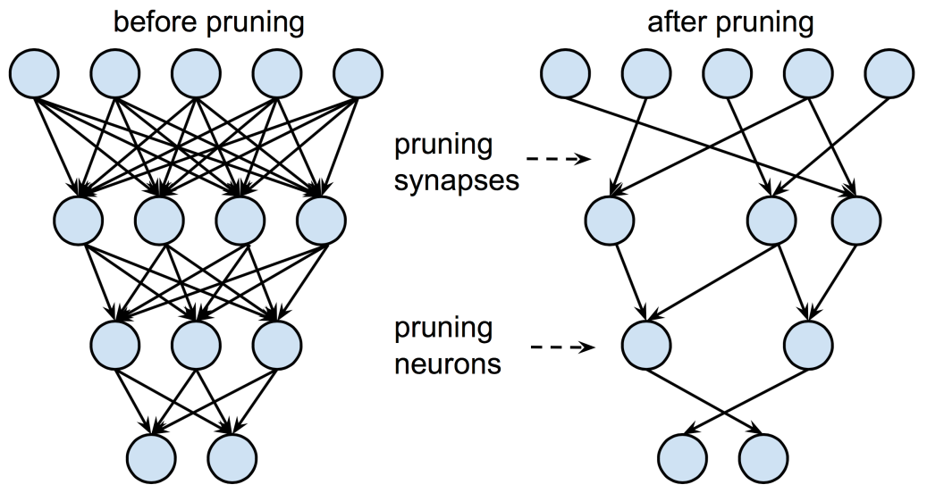
Transfer Learning in “Traditional” DL/ML
Why do we need smaller models?
Employing on edge devices/AIoT devices.
Low computation power, demand high energy efficiency, sensitive to cost.
Previously: compress large models with weight pruning and quantization method.
Possible disadvantage: complexity in implementation and long iterative process.
Easier solution to train a “smaller” yet “effective” model from large models?

Slide 22
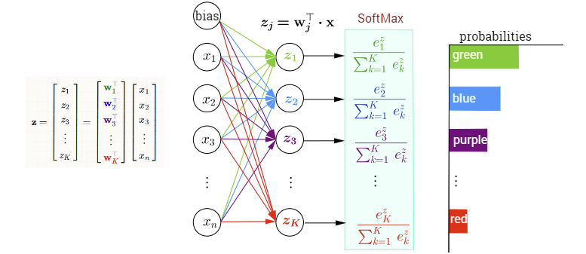
Knowledge Distillation: Transfer from Larger to Smaller Models
Easier solution to train a “smaller” yet “effective” model from large models?
Recall: (for classification task) what we essentially obtain: probabilities!
The mindset: as long as the smaller model outputs similarly to the larger model, then the capability of the smaller model should also be similar to the larger model!

Slide 23
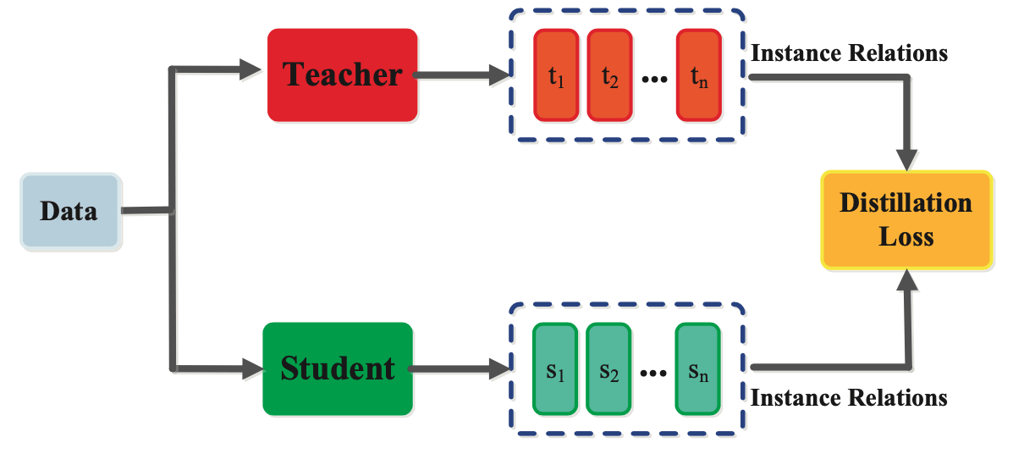
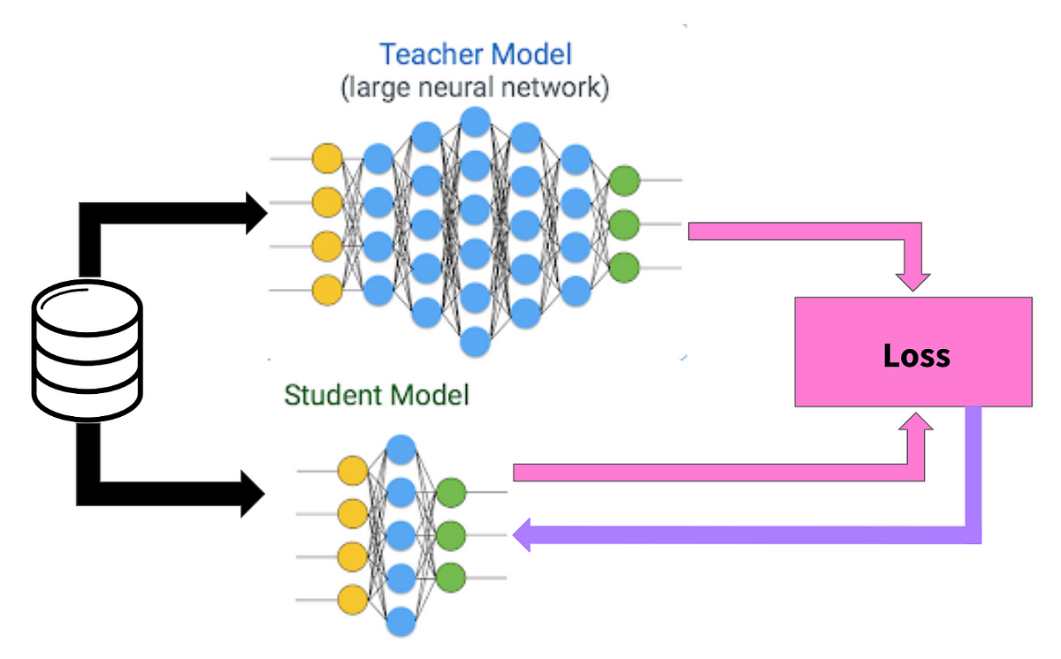
Knowledge Distillation
Distillation loss: match the outputs of the teacher and student network.
Teacher-student structure widely used for transfer learning. Teacher can be frozen, loss acting on the student network.
Common loss: KL-divergence or cross-entropy loss.

Slide 24
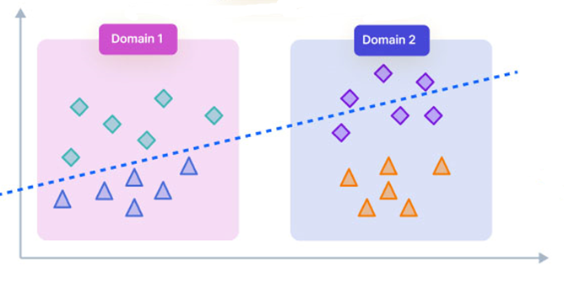
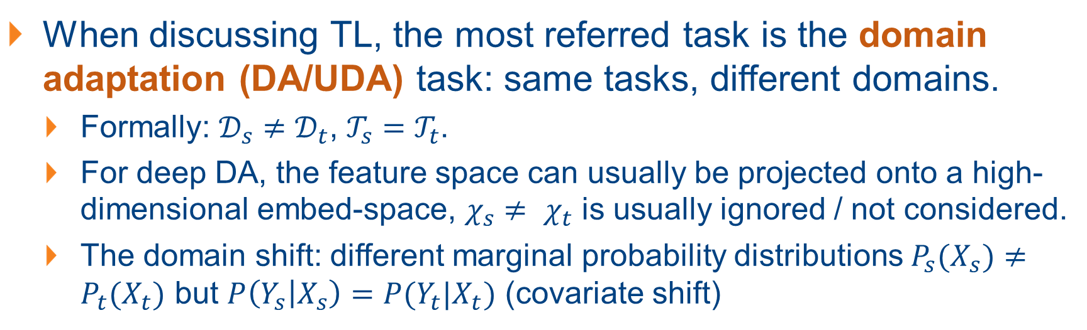
(Deep) Domain Adaptation: the Narrow TL
When discussing TL, the most referred task is the domain adaptation (DA/UDA) task: same tasks, different domains.
Formally: $𝒟_{s}≠𝒟_{t}$, $𝒯_{s}=𝒯_{t}$.
For deep DA, the feature space can usually be projected onto a high-dimensional embed-space, $χ_{s}$ $≠ χ_{t}$ is usually ignored / not considered.
The domain shift: different marginal probability distributions $P_{s}(X_{s})≠P_{t}(X_{t})$ but $P\left(Y_{s} | X_{s}\right)=P(Y_{t}|X_{t})$ (covariate shift)

Slide 25
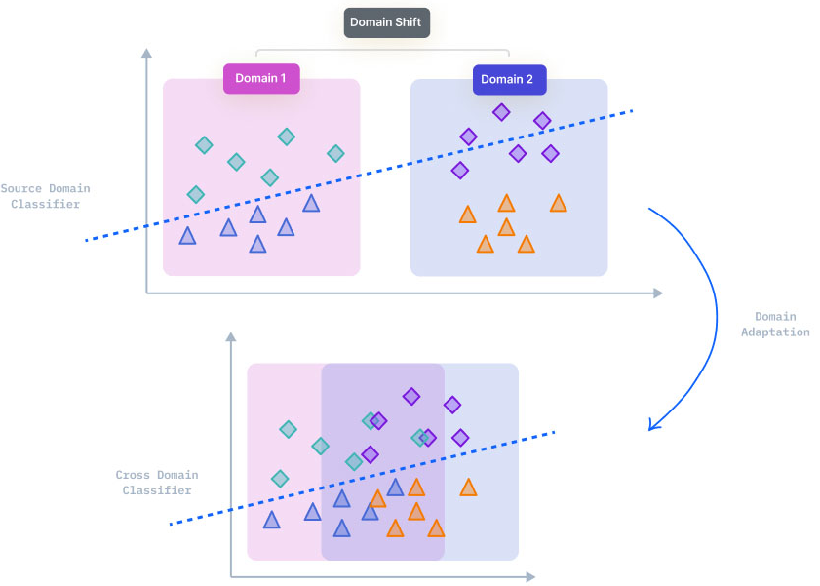
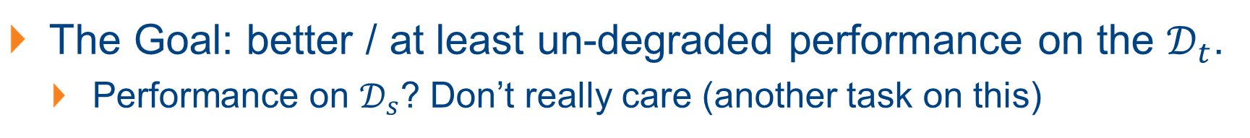
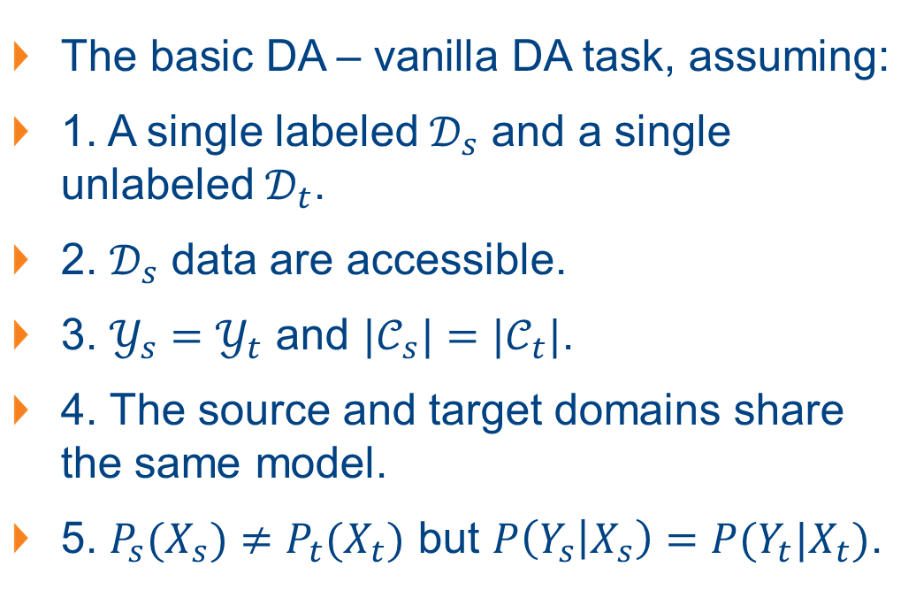
Domain Adaptation: the Goal and Assumptions
The Goal: better / at least un-degraded performance on the $𝒟_{t}$.
Performance on $𝒟_{s}$? Don’t really care (another task on this)
The basic DA – vanilla DA task, assuming:
1. A single labeled $𝒟_{s}$ and a single unlabeled $𝒟_{t}$.
2. $𝒟_{s}$ data are accessible.
3. $𝒴_{s}=𝒴_{t}$ and $|𝒞_{s}|=|𝒞_{t}|$.
4. The source and target domains share the same model.
5. $P_{s}(X_{s})≠P_{t}(X_{t})$ but $P\left(Y_{s} | X_{s}\right)=P(Y_{t}|X_{t})$.
Notes:
Prior Probability Shift: Shift in the target variable.
Concept Drift: Shift in the relationship between the independent and the target variable.
A Concept shift is a change in the mapping between features and targets, while the features themselves remain unchanged.

Slide 26
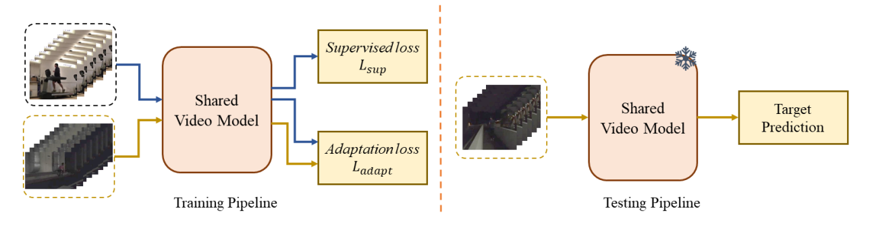
The Training and Testing Pipeline
What are we able to access:
Source data, source label, and target data.

Slide 27
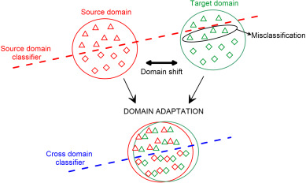
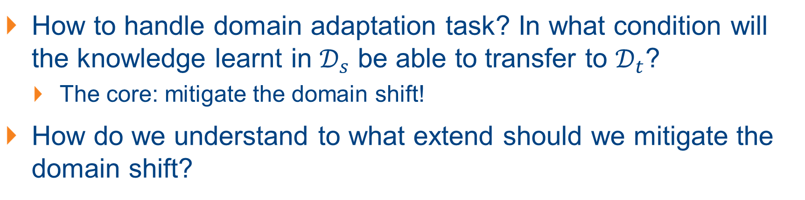
The Intuitive Strategy: Discrepancy-based DA
How to handle domain adaptation task? In what condition will the knowledge learnt in $𝒟_{s}$ be able to transfer to $𝒟_{t}$?
The core: mitigate the domain shift!
How do we understand to what extend should we mitigate the domain shift?
The intuitive idea: can we specifically quantify the amount of domain shift (gap) and minimize this gap?
Mitigate domain shift explicitly: also known as minimizing the domain discrepancy between source and target domains.

Slide 28
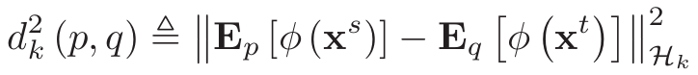
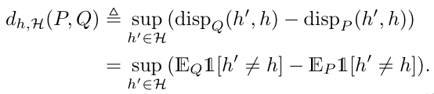
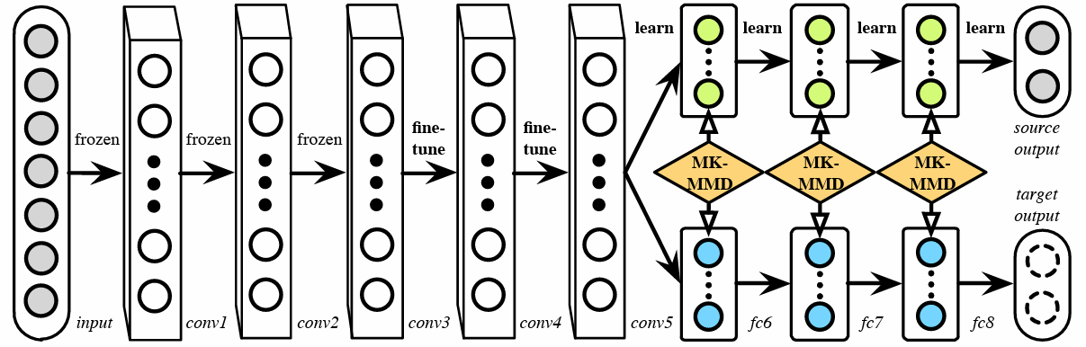
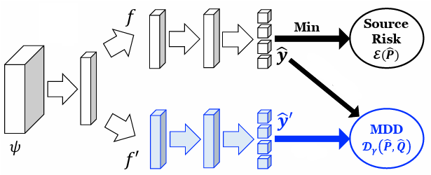
Examples of Discrepancy-based DA
Where to apply the discrepancy: usually across high-level features.
The specific discrepancy-based method depends on how the discrepancy (i.e., domain shift) is computed. Two examples:
1. MMD (Maximum Mean Discrepancy)
2. MDD (Margin Disparity Discrepancy)

Slide 29
Pros and Cons of Discrepancy-based DA
Discussion: what are the pros and cons of discrepancy-based domain adaptation?
Pros: domain shift is measured (explicitly) through a certain discrepancy. Thus the training is stable, with the result backed by certain theoretical results.
Cons: domain shift may be hard to model accurately. Actual implementation is also usually “simplified”. May not result in a “global optimal” solution.

Slide 30
The Alternative: Mitigate Domain Shift Implicitly
Modelling the domain shift explicitly is difficult, how shall we mitigate the domain shift implicitly?
The equivalent question: what would happen if the domain shift is mitigated (or best, eliminated)?
The source and target domains will be indistinguishable!
Does this sound familiar?

Slide 31
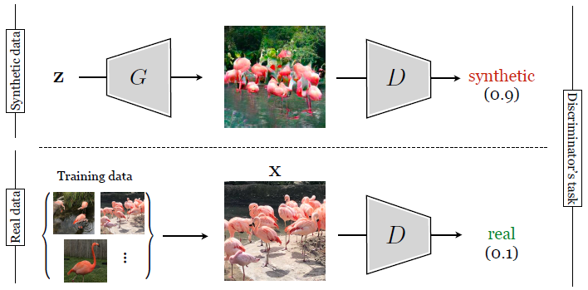
Adversarial-based DA
Recall GAN: generative adversarial network, generates synthetic images similar to real images by training the generator to fool the discriminator.
Extend it to domain adaptation: we can train the shared model (replacing the generator) to fool the domain classifier (replacing the discriminator) so that the domain classifier cannot classify the domain of the data.
Minmax game for generation → Minmax game for domain adaptation.

Slide 32
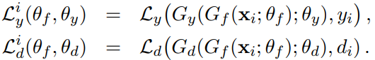
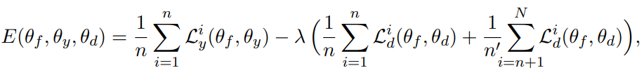
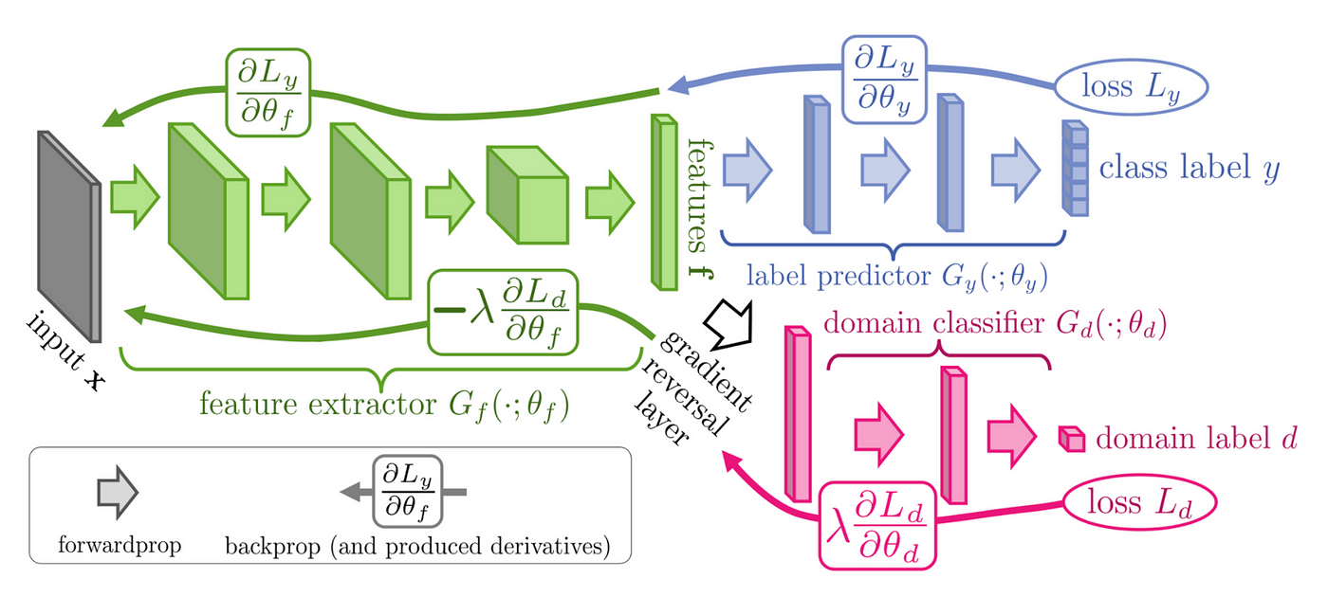
Adversarial-based DA
Train the shared model to fool the domain classifier so that the domain classifier cannot classify the domain of the data.
Open discussion: pros and cons of adversarial-based DA?

Slide 33
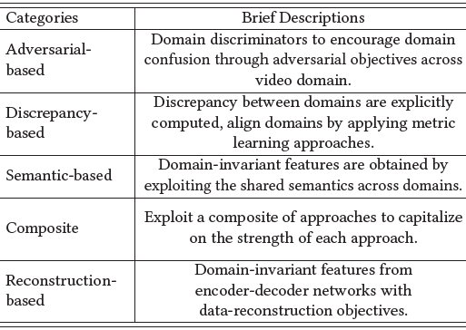
More Strategies for Tackling DA
Tackling DA is not a trivial problem. There are much more types of strategies to look for beyond discrepancy-based and adversarial-based methods.

Slide 34
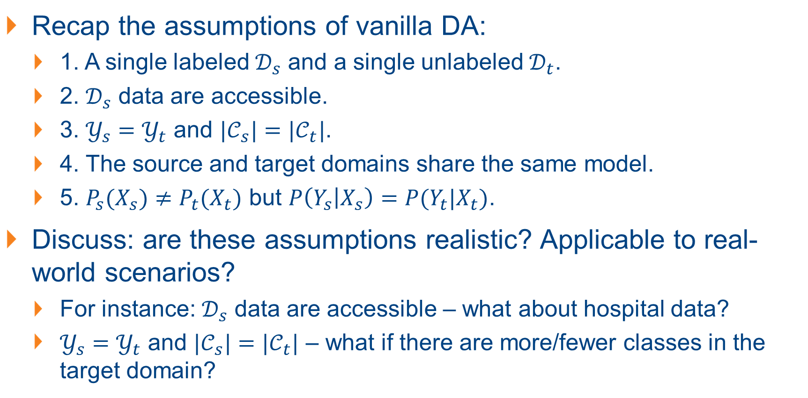
Variants of Vanilla DA
Recap the assumptions of vanilla DA:
1. A single labeled $𝒟_{s}$ and a single unlabeled $𝒟_{t}$.
2. $𝒟_{s}$ data are accessible.
3. $𝒴_{s}=𝒴_{t}$ and $|𝒞_{s}|=|𝒞_{t}|$.
4. The source and target domains share the same model.
5. $P_{s}(X_{s})≠P_{t}(X_{t})$ but $P\left(Y_{s} | X_{s}\right)=P(Y_{t}|X_{t})$.
Discuss: are these assumptions realistic? Applicable to real-world scenarios?
For instance: $𝒟_{s}$ data are accessible – what about hospital data?
$𝒴_{s}=𝒴_{t}$ and $|𝒞_{s}|=|𝒞_{t}|$ – what if there are more/fewer classes in the target domain?

Slide 35


Variants of Vanilla DA
Vanilla DA is also referred to as closed-set (U)DA:
From the definition that $𝒴_{s}=𝒴_{t}$ and $|𝒞_{s}|=|𝒞_{t}|$.
Partial-set UDA (PDA)
Label space constraint
Open-set UDA (OSDA)
Multi-source UDA (MSDA)
Difference from closed-set UDA?
Source data assumption
Source-free UDA (SFDA)
Black-box UDA (BVDA)
Test-Time UDA (TTA)
Target data assumption
Zero-shot VUDA (VDG)

Slide 36
Few-shot Learning
Few-shot Learning: Concepts and Basic Ideas
Few-shot Domain Adaptation

Slide 37
Limitations (?) of Transfer Learning
What advantage does transfer learning bring to us?
Knowledge from the source model (good initialization);
No need for data annotation (i.e., labels);
What does transfer learning still requires?
Data;
And of course, the process of data collection!

Slide 38

How Humans Learn?
Let’s go back and see how humans can learn, see if the current methods can do the same:
Humans can learn a novel concept from a few samples:

Slide 39
Learning with Less Data
Goal: let learning algorithms learn from only a few samples:
May need label, but since only need a few samples, also means that only need a few labels;
Collecting limited labels and annotating them is rather straightforward.
Concept: few-shot learning.
How can we achieve few-shot learning?

Slide 40

Learning with Less Data
The intuitive idea: supervised learning, since data-label pairs are available.
The issue: learning with insufficient data causes overfitting.
Then why humans can learn with few data without overfitting?
Humans can learn quickly as we have a lot of relevant experience.

Slide 41

Few-Shot Learning: the N-way K-shot Task
The few-shot learning task is usually formulated as an N-way K-shot learning task:
N-way: N novel classes;
K-shot: K data for each class (known also as the support set)
Where to test: on the “query set”: with Q query data (sometimes will also be formulated as Q query data for each of the N classes)

Slide 42
Baseline: Nearest Neighbor / Centroid
Step 1: Train a classifier for all base classes. (1st stage)
Step 2: Remove the last FC layer and obtain a feature encoder.
Step 3: In a FSL task: compute the mean feature for each class in the support set, classify the query set by nearest neighbor.

Slide 43
The Limitations of the Baseline
Requires a pre-training process even before the formal FSL process.
The data of the base classes must be highly correlated with the novel classes.
Can we directly optimize towards the FSL tasks?

Slide 44
Optimize Towards FSL: Meta-Learning
More often, what we have is a pool of classes with readily available data-label (public datasets), and our FSL requires to learn for novel classes with only few labeled data.
The idea: learning to summarize from few data with the sufficient data-label pairs, then apply to the novel classes:
Meta-learning – learning to learn, learning through multiple episodes.
In the classic paradigm, when we have a specific task, an algorithm is learning if its task performance improves with experience.
In the Meta-Learning paradigm, we have a set of tasks. An algorithm is learning to learn if its performance at each task improves with experience and with the number of tasks.

Slide 45

Meta-Learning for Few-shot Learning
We have the N-way K-Shot task (TEST) and a large base-dataset that we’ll use as a Meta-Learning training set (TRAIN);
The whole Meta-Training process will have a finite number of episodes. We form an episode as below:
Step 1: From the TRAIN, we sample N classes and K support-set images per each class, along with Q query images. This way, we form a classification task that’s similar to our ultimate TEST task.
Step 2: At the end of each episode, the model are trained to maximize the accuracy of Q images from the query set. This is where our model learns the ability to solve an unseen classification problem.

Slide 46
Meta-Learning for Few-shot Learning
How to evaluate with the meta-learning paradigm?
The overall efficiency of the model is measured by its accuracy on the TEST classification task.
We use a set of test tasks. Each contains only unseen classes.
For each, we measure accuracy on the query set based on knowledge of their support set.
If there are more than K data per class, the data of the test tasks are randomly drawn (for both the support set and query set).

Slide 47
Combining FSL and TL: Few-Shot DA
Why FSDA? It is more practical to obtain a few labeled videos during the early stage of model deployment to improve the transferred models’ performances in the target environment.
Combines the lack of data “few-shot”, with domain shift “DA”.
Note the difference between FSDA and FSL:
FSDA: focus on domain shift (difference), but the label space (i.e., classes) are exactly the same!
FSL: focus on learning in “novel classes”, but presumably, the data are within the same “domain”.

